Slide 1
Zero-shot iNat Classification + Detection

Slide 2
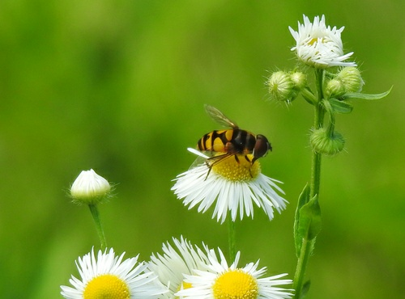
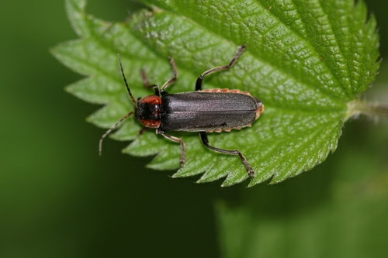
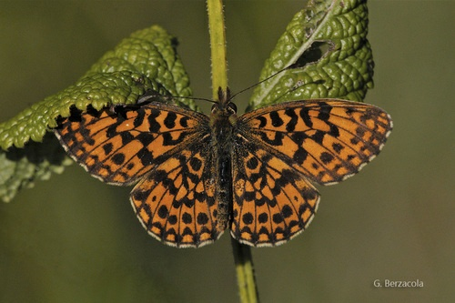
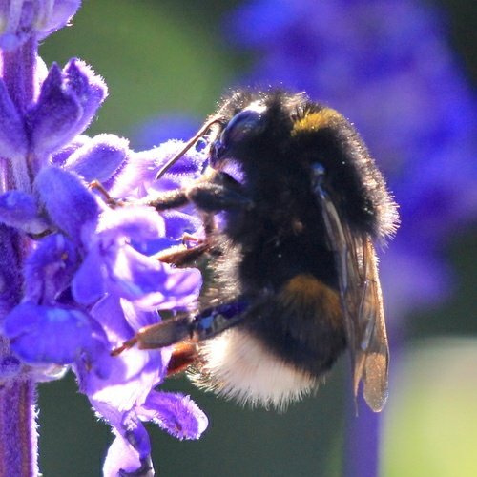
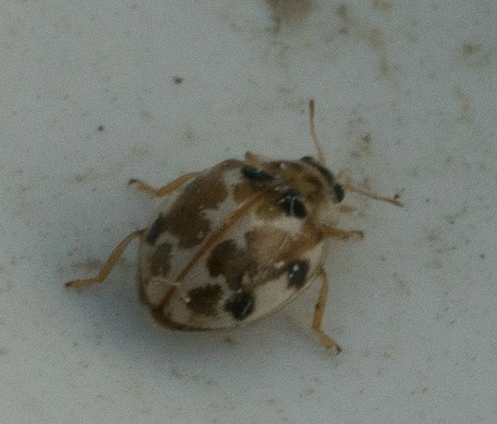
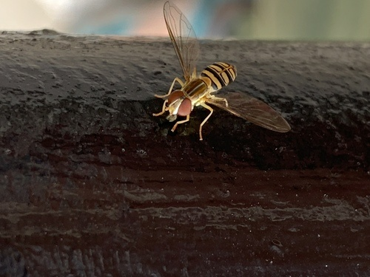
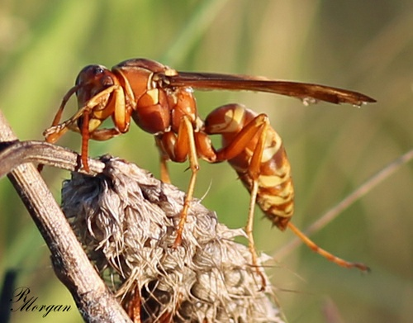
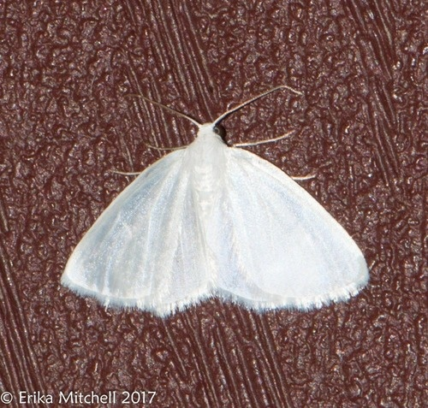
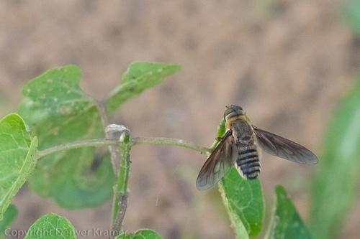
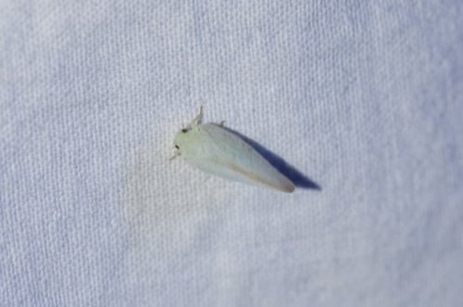
Insect classes...
Cantharis_fusca
Eristalis_transversa
Bombus_terrestris
Boloria_dia
Psyllobora_vigintimaculata
oxomerus_politus
Polistes_apachus
Lomographa_vestaliata
Poecilanthrax_lucifer
Ormenoides_venusta

Slide 3
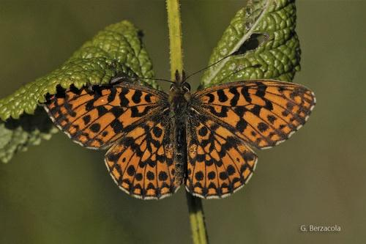




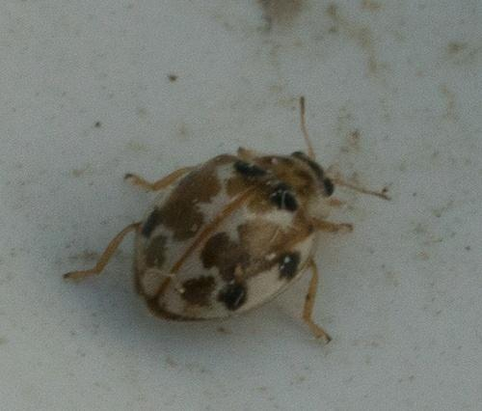
Selected 6 distinguishable classes
Cantharis_fusca
(Folder 1)
Ormenoides_venusta
(Folder 4)
Boloria_dia
(Folder 6)
Psyllobora_vigintimaculata
(Folder 2)
Poecilanthrax_lucifer
(Folder 3)
Lomographa_vestaliata
(Folder 5)

Slide 4
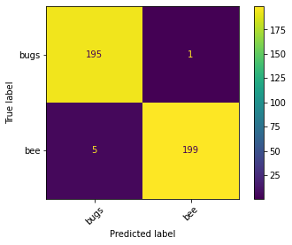
Binary classification on classes with low similarity
Text ‘A picture of yellow insect with brown wings’ given to CLIP for ‘Bee’ classification
Total ‘Bee’ Class images = 200
Text ‘A picture of beetle with black spots’ given to CLIP for ‘Bug’ classification
Total ‘Bug’ Class images = 200
Confusion matrix
Examples of Psyllobora_vigintimaculata dataset
Examples of Poecilanthrax_lucifer dataset
Accuracy 98.5

Slide 5
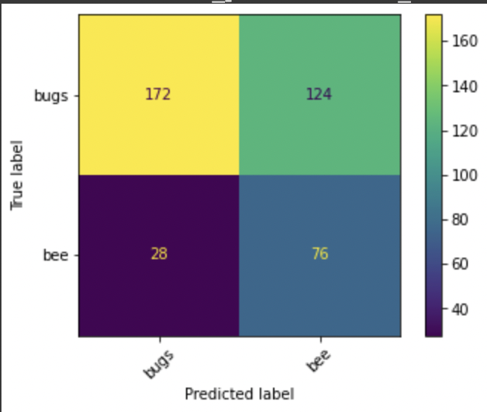
Binary classification on classes with high similarity
Text ‘A picture of yellow insect with brown wings’ given to CLIP for ‘Bee’ classification
Total ‘Bee’ Class images = 200
Text ‘A picture yellow insect with invisible/ transparent wings’ given to CLIP for Other Bee classification
Total ‘Bug’ Class images = 200
Confusion matrix
Poecilanthrax_lucifer
Eristalis_transversa
Accuracy 62%

Slide 6
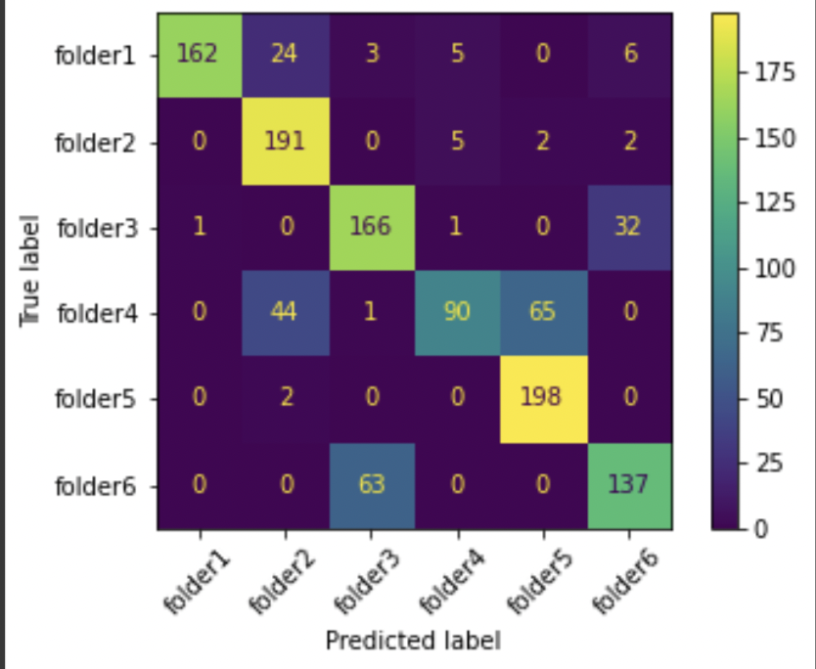
Multiclass classification (6 classes), first attempt
Confusion matrix
a picture of white bug with black color spots
a picture of a yellow insect with brown wings
a picture of black color insect with orange head
a picture of green color insect without wings
a picture of white color insect
a picture of insect with black spots on brown wings
Accuracy 78%

Slide 7
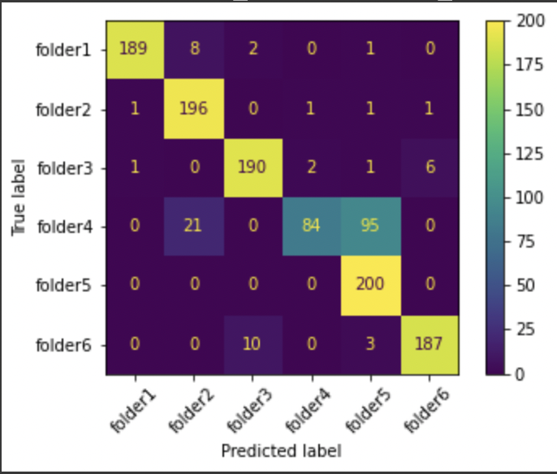
Prompt Engineering
a photo of white bug with black color spots, a type of insect
a photo of a yellow insect with brown wings , a type of insect
a photo of black color beetle with orange head, a type of insect
a picture of green color insect
a picture of insect with black spots on brown wings, a type of butterfly
a photo of white color insect, a type of moth

Slide 8
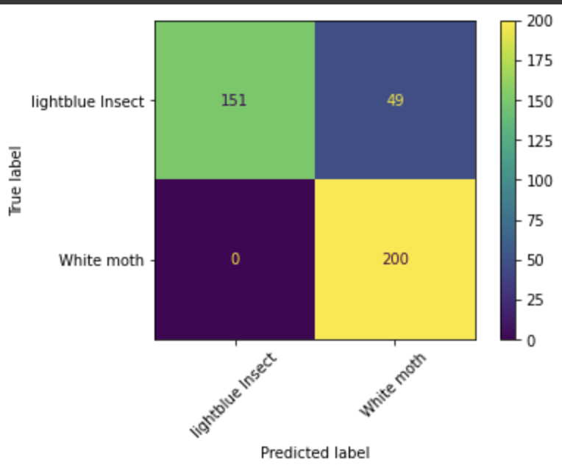
Prompt Engineering between planthopper and moth
Planthopper -> Used Light green insect, looks like petal
Moth - a photo of white color insect, a type of moth

Slide 9
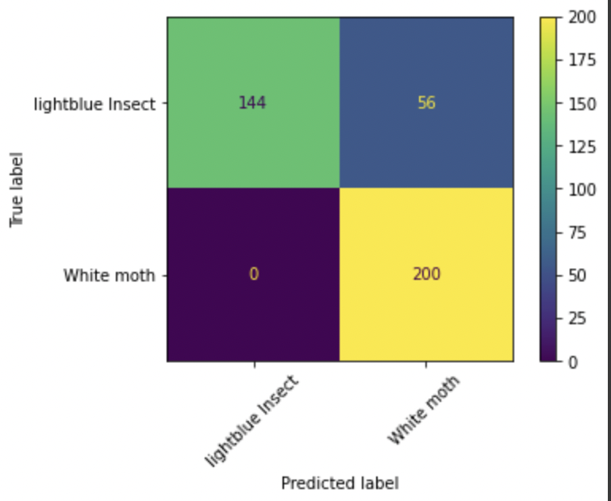
Added mode features
planthopper - a photo of light green color insect,
a type of planthopper, looks like peas
Moth - a photo of white color insect, a type of moth

Slide 10
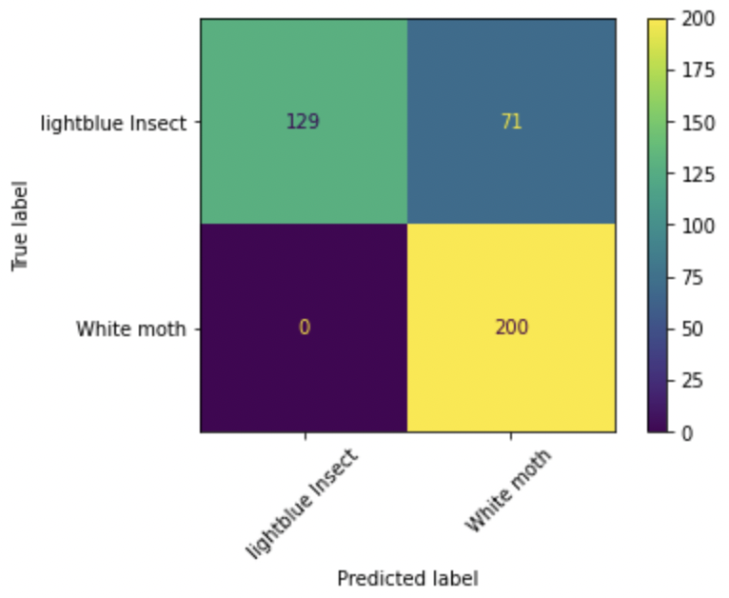
Changes based on color
Planthopper - a photo of planthopper
Moth - a photo of a moth

Slide 11
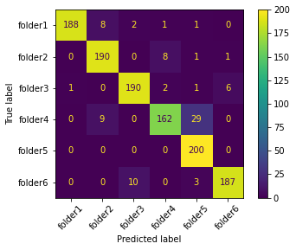
More prompt engineering, final results
a photo of white bug with black color spots, a type of insect
a photo of a yellow insect with brown wings , a type of insect
a photo of black color beetle with orange head, a type of insect
a photo of Light green insect, looks like petal
a picture of insect with black spots on brown wings, a type of butterfly
a photo of white color insect, a type of moth
Accuracy = 93.083

Slide 12
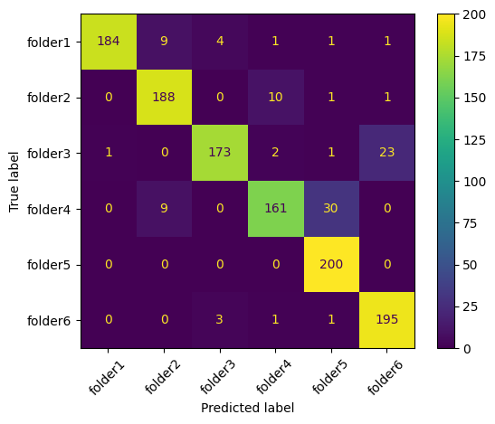
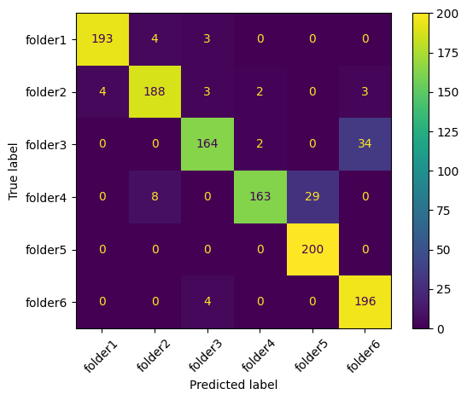
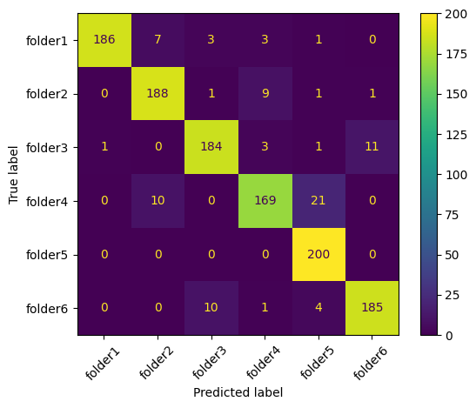
Prompt templates recommended by CLIP give boosts
A bad photo of {}
Accuracy : 91.75
A Origami of {}
Accuracy : 92
A photo of a large {}
Accuracy : 92.67

Slide 13
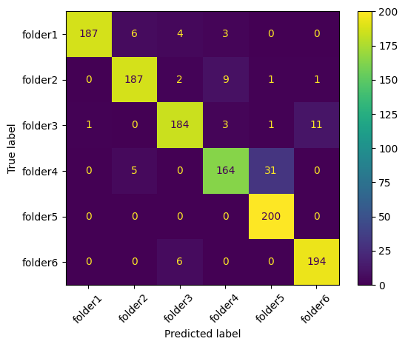
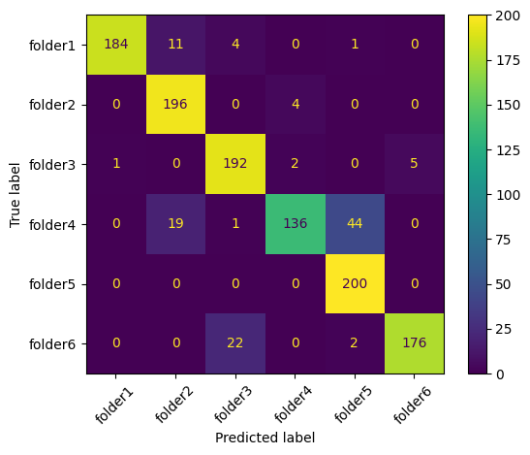
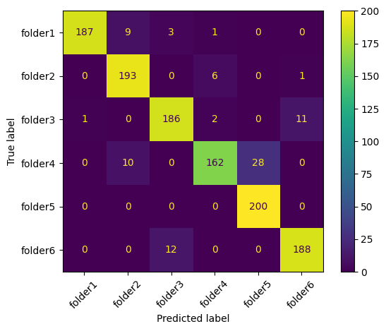
Use of templates described in paper
Itap of a {}
Accuracy : 93
A photo of a small {}
Accuracy : 93
Art of the {}
Accuracy : 90.33

Slide 14
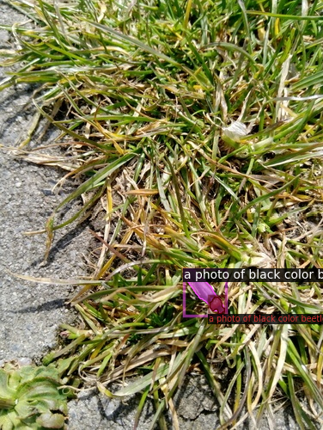
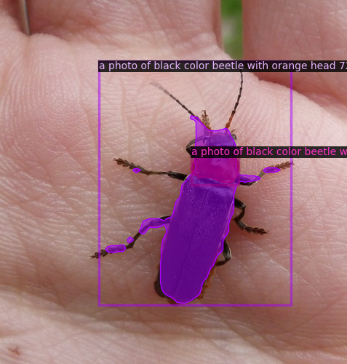
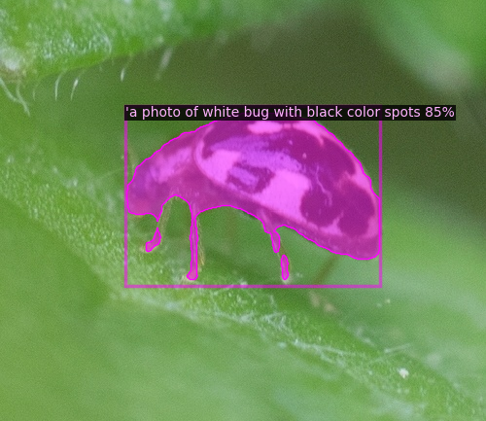
Ongoing work: Bounding boxes using Detic

Slide 15
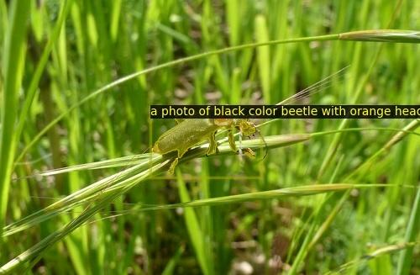
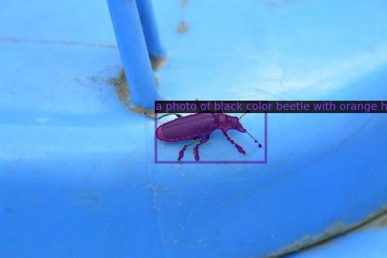
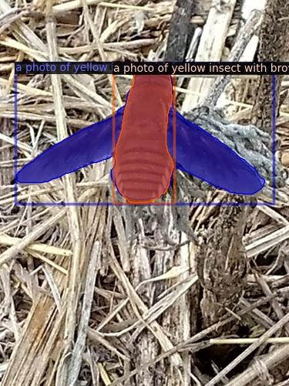
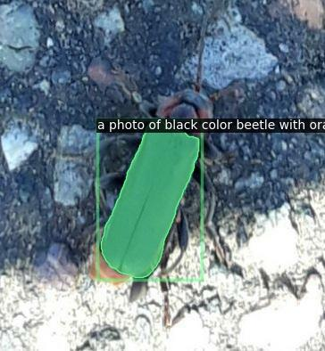
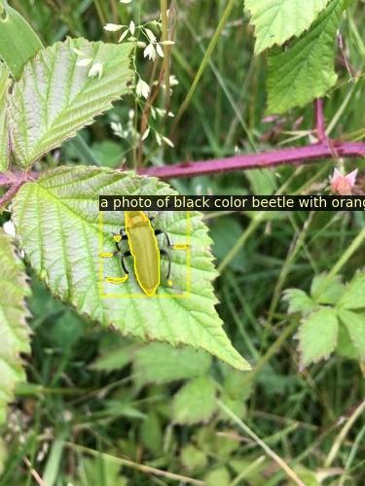
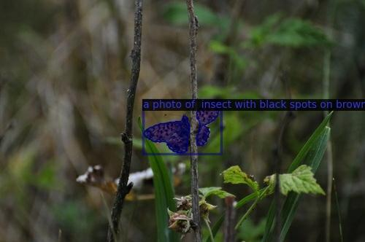
Examples of bounding boxes using DETIC

Slide 16
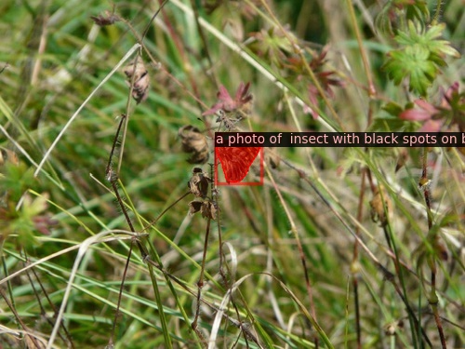
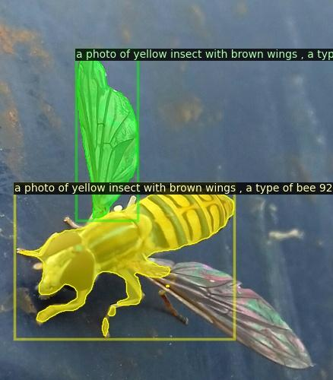
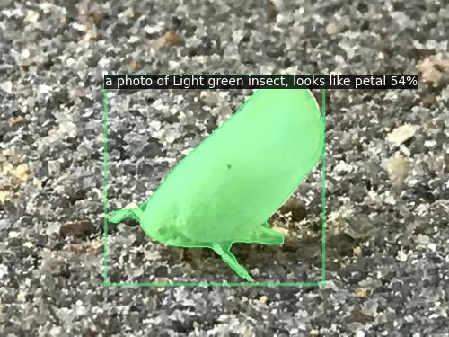
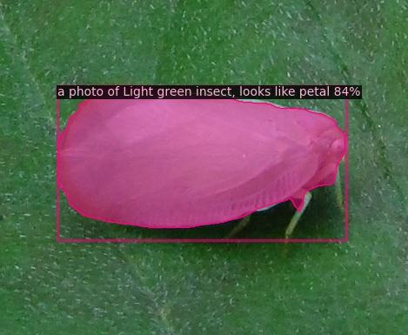
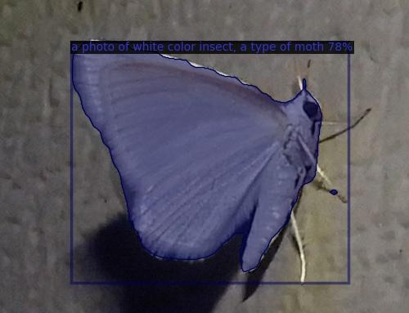
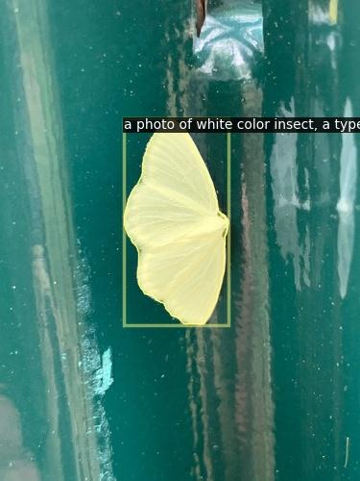
Examples of bounding boxes using DETIC

